Slide 1
What is Adventure Therapy?
Most Recognized Definition:
The prescriptive use of adventure experiences provided by mental health professionals, often conducted in natural settings that kinesthetically engage clients on cognitive, affective, and behavioral levels (Gass, et.al. 2012).

Slide 2
Where Does Adventure Therapy Fit?
Experiential and Creative Methods
Adventure Therapy
Play, Art, Animal, Ecotherapy, etc.
Wilderness Therapy
High/Low Ropes
Smaller Initiatives

Slide 3
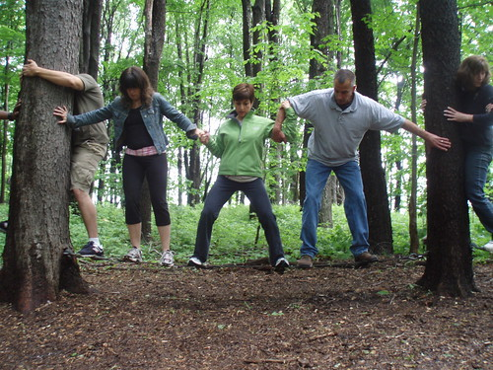
Breaking Down the Definition
Prescriptive
Intentional choices based on clients’ individual needs or group needs.
Provider is a Mental Health Professional
Clinical training is utilized and ethical standards are expected.
Kinesthetic Engagement
Movement is included in some way throughout 51% of the process

Slide 4
Challenge By Choice always in effect!
What does this mean and why is it important in AT?
This allows the participant/client to choose their level of involvement, while also learning the outcome of that choice.
Brainstorm: In what ways can you incorporate AT interventions into your work.
Exp: Walk & Talks, Experiential activities aligned with clinical goals and client interest, utilize local businesses for experiences (Vertical Adventures), Isomorphic metaphors at local parks, clients backyards, Use of Fire for ceremonies or mindfulness.

Slide 5
How Does it Work?
Novel Setting
Isomorphic Metaphor
Natural Feedback

Slide 6
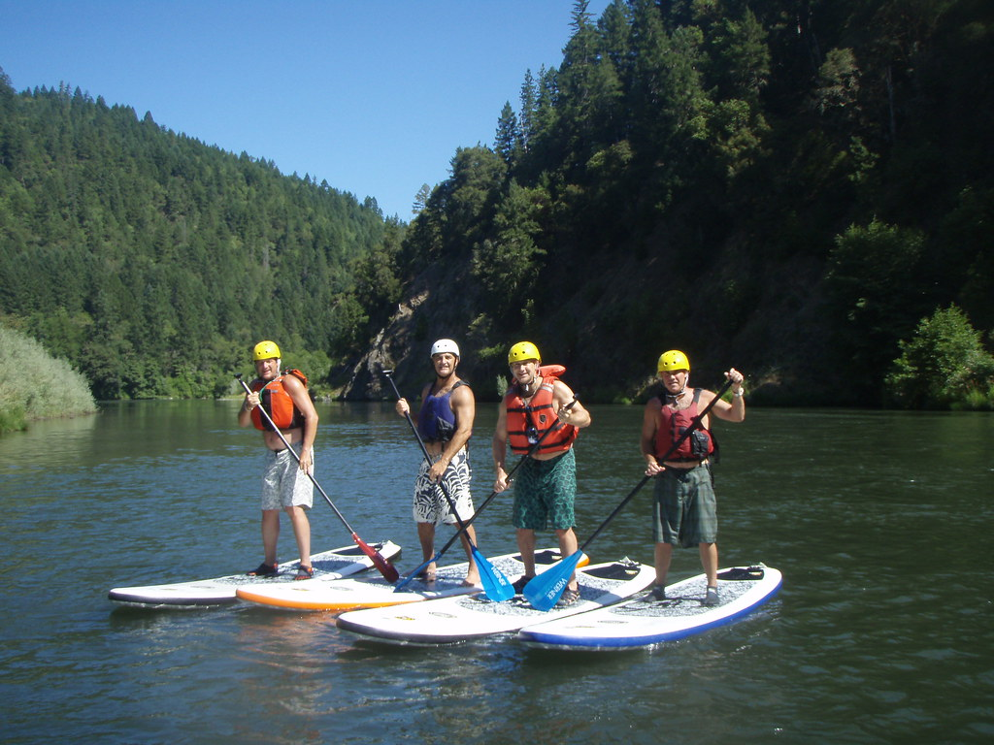
Novel Setting
Change is promoted through the novelty of the experience and the environment.
Provides opportunities for conversation and expression

Slide 7
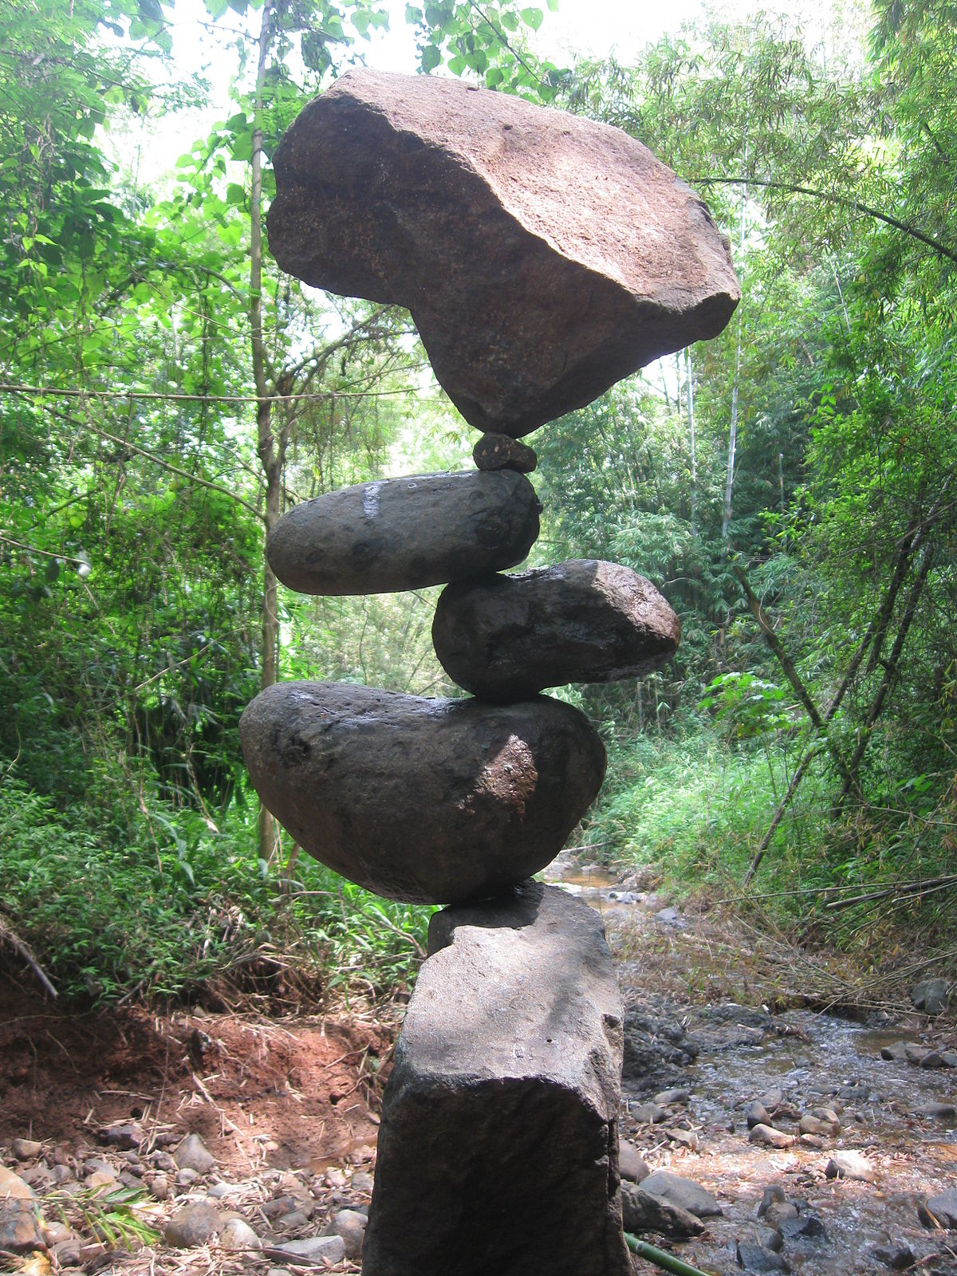
Isomorphic Metaphors
Concrete experiences with isomorphic metaphors generalize therapeutic goals to everyday life.
Activity and metaphor are intentionally chosen by counselor.

Slide 8
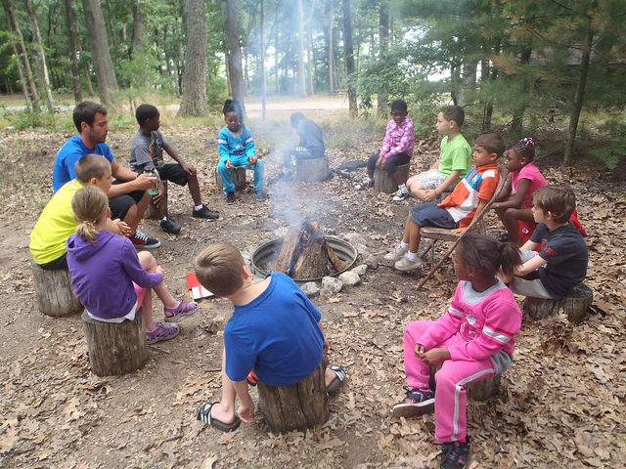
Natural Feedback
The activity and nature are impartial parties in the therapeutic relationship, which encourages introspection.
Consequences are a direct and concrete reaction to their behavior.
Encourages change and reinforces success.

Slide 9
Core of AT Processing What? So what? Now What?

Slide 10
What?
What? What Happened? Share Observations.
What did you observe? Allow clients to state what they observed. Hold space for this.
Attention should be given to the effectiveness of the group process, task accomplishment, and individual contributors.

Slide 11
So What?
So What? Form abstract concepts and generalizations.
Analyze what happened, and discuss impacts on the group or individual.
Determine what worked well and where we can improve.
Develop an action plan where new ideas and concepts can be implemented next time.

Slide 12
Now What?
Now What? Activate experimentation.
If we did this activity again, knowing what we know now, using the tools we learned, what would be different?
Can we try again with this new information?
This is generally where the “homework” portion of traditional talk therapy comes in, but we are doing this together, further strengthening the therapeutic alliance, as well as implementing the “now what” at the point of performance.
Relating the now what to clinical goals and helping the client make the connection.

Slide 13
The Facilitated Wave Model
Event
Environment
Response
Point A
Point B

Slide 14
GRABBSS Assessment
Goals- of the Activity
Readiness- for the activity
Affect- of the individual or group at this time
Behavior- of the individual or group at this time
Body- considerations
Stage- of the individual or group development at this time
Setting- considerations for the activity

Slide 15
Multicultural and International Considerations
USA is a risk adverse legalistic society. We are more highly regulated and insist on training, certification, licensure, and demonstrated competence. Most other countries are not.
Primary source of research is USA centric. Although this has pushed the field forward, this has run at odds to other nations conceptualization of Adventure Therapy.
Australia and New Zealand: Bush Adventure Therapy
Many rites of passage or First Peoples ceremonies/traditions have been modified or used. Need awareness, respect, and recognition of this.

Slide 16
Helpful Resources:
Adventure Therapy: Theory Research and Practice by Gass, Gillis, and Russell
Active Interventions for Kids and Teens: Adding Adventure and Fun to Counseling by Ashby, Kottman, and DeGraaf
Association of Experiential Education: www.aee.org
Certification: https://www.aee.org/application-and-documents
Therapeutic Adventure Professionals Group (TAPG): www.aee.org/tapg
Journal of Experiential Education (JEE)
Yearly Conference with TAPG Pre-conference
Outdoor Behavioral Healthcare Council: https://obhcouncil.com/
2 yearly Wilderness Therapy Symposiums – 1 east coast USA, one near the Rockies USA
International Adventure Therapy: https://internationaladventuretherapy.org/
International Adventure Therapy Conference every 3 years
Australian Association for Bush Adventure therapy Inc: https://aabat.org.au/
Yearly AABAT Forum/Conference
Adventure Therapy Europe: http://adventuretherapy.eu/
Conference every 2 years: http://adventuretherapy.eu/gate/

